Slide 1
Further Improving Oslo’s Cycling Infrastructure
A suitability analysis for GEO4460
by Per Halvorsen
pmhalvor@uio.no

Slide 2
Overview
Goal
Data
Criteria
Development
Discussion
Summary

Slide 3
Goal
Can we use publicly available data to improve cycling conditions routes around Oslo?

Slide 4
Data Sources
Strava API
Segments
Activities
Statens Vegvesen Traﬀic Data
Kartverkets N50 Data
Sykkel ruter i Oslo (Oslo Kommune)

Slide 5
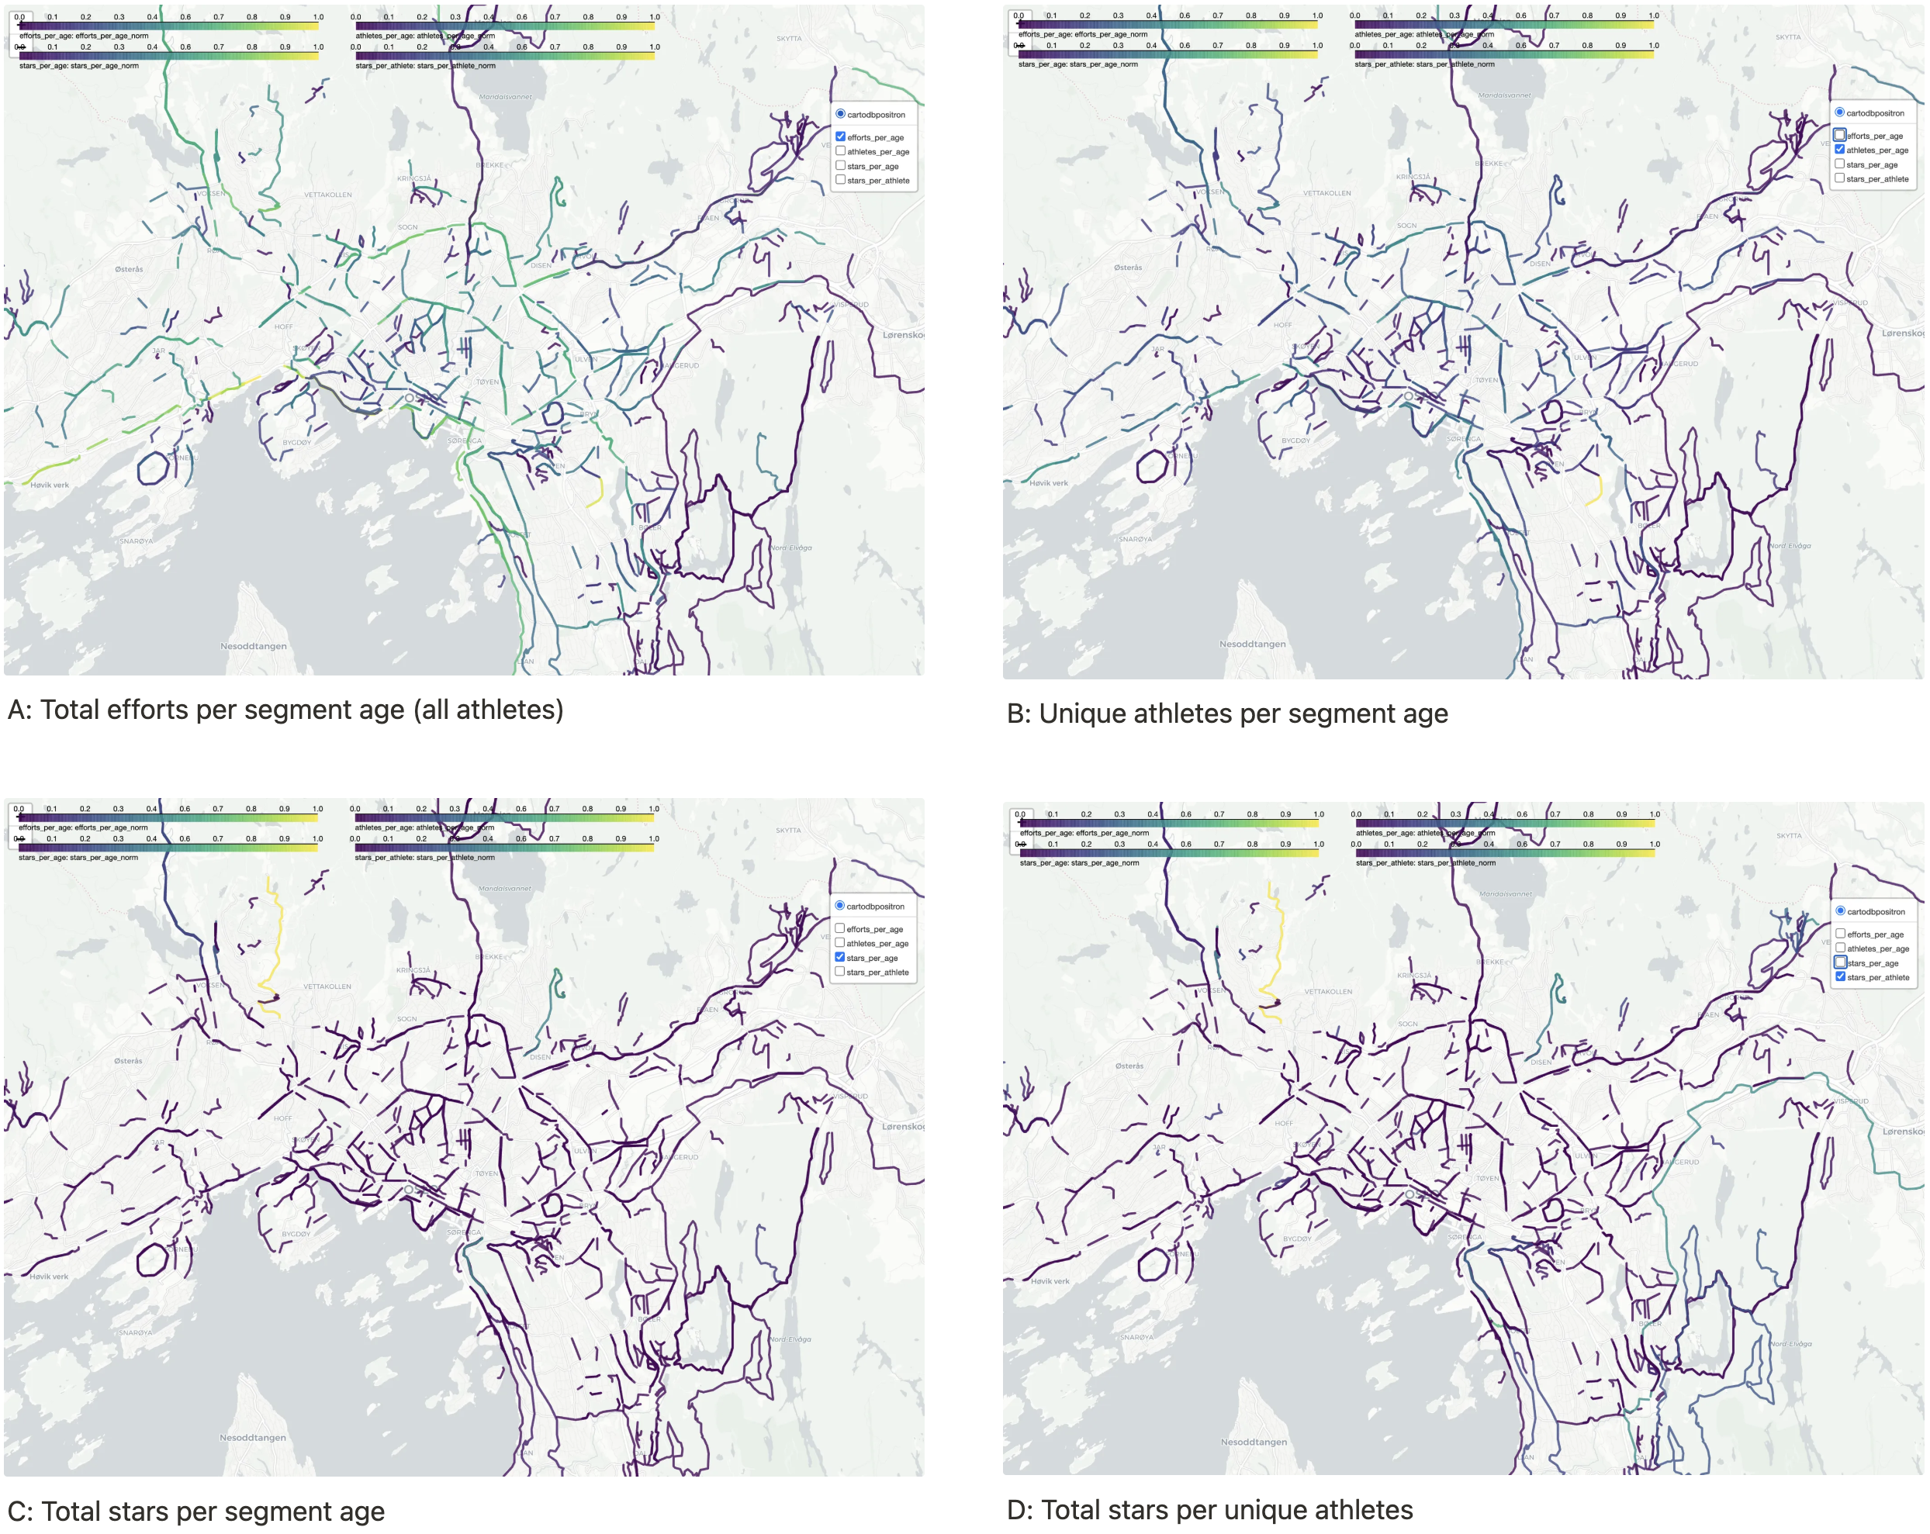
Data Sources
Segments

Slide 6
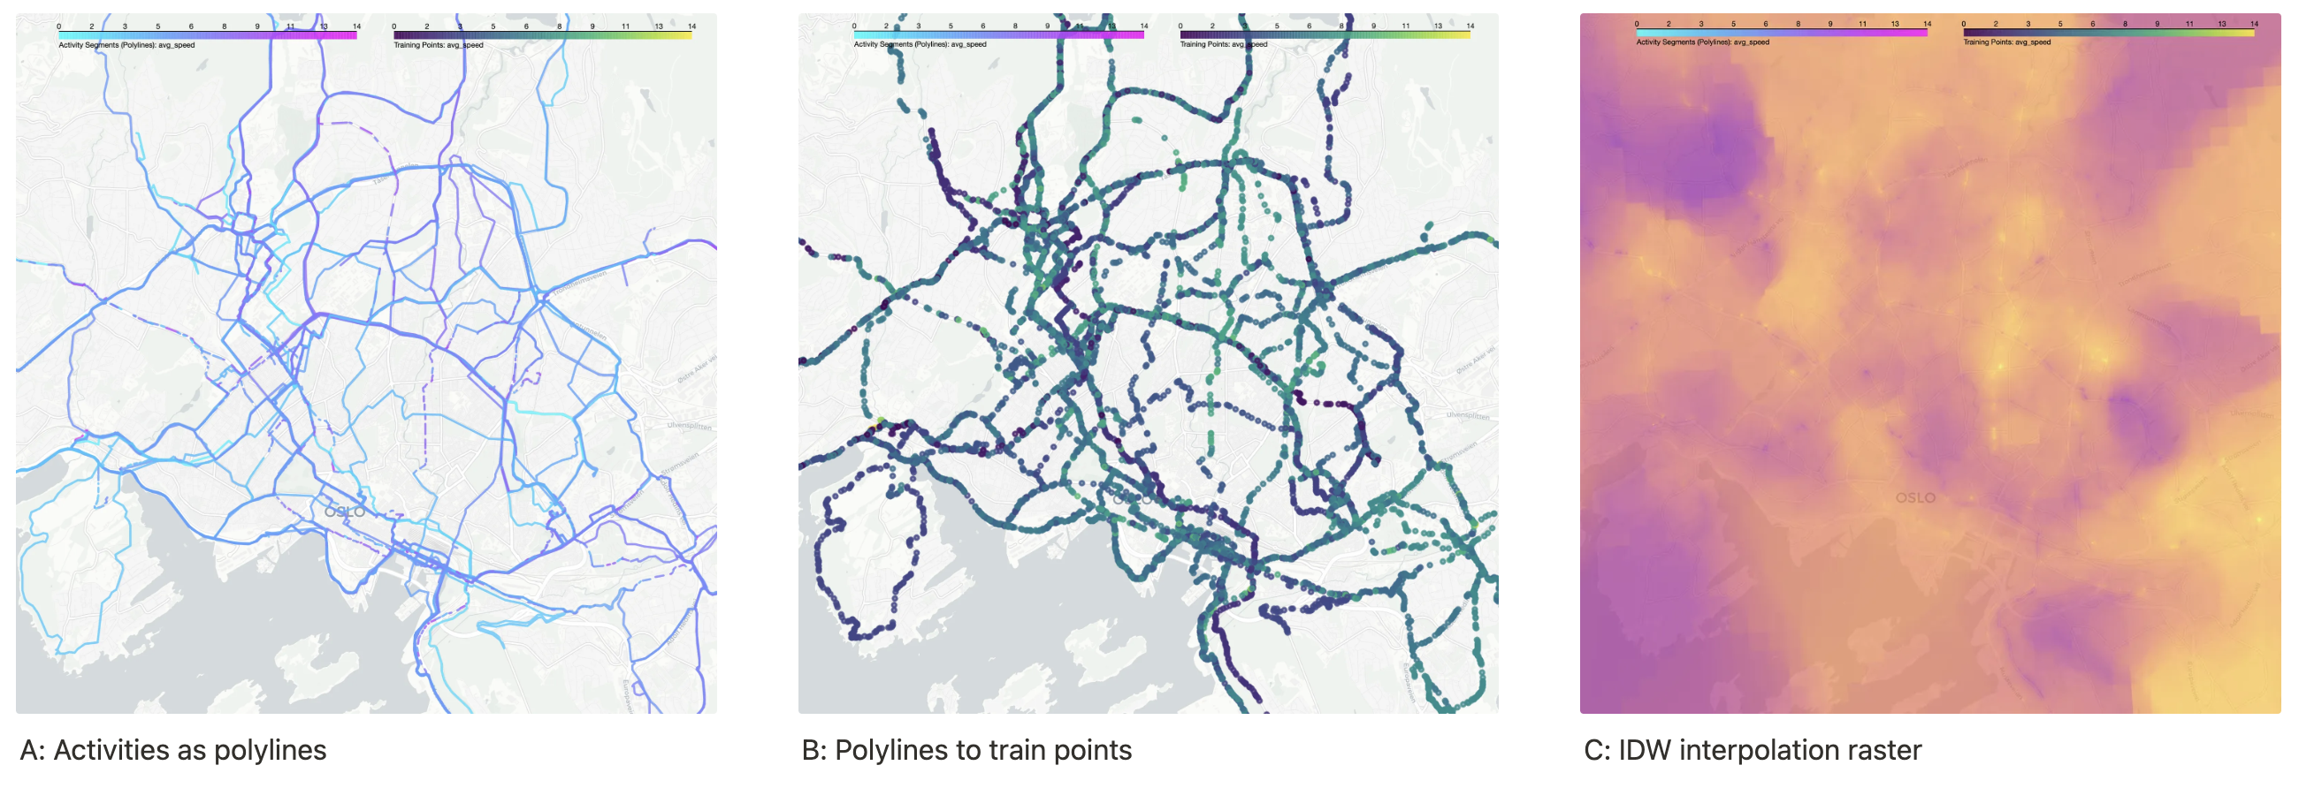
Data Sources
Activities

Slide 7
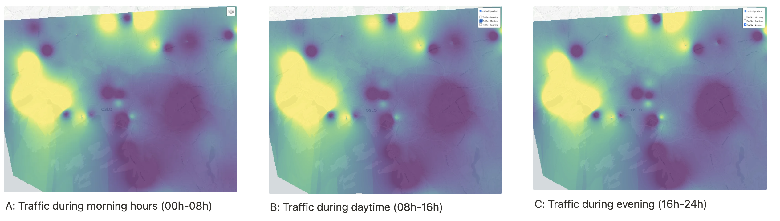
Data Sources
Traffic

Slide 8
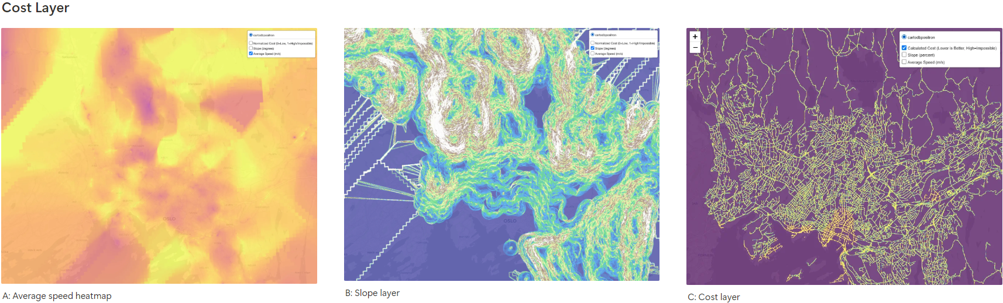
Data Sources
Elevation

Slide 9
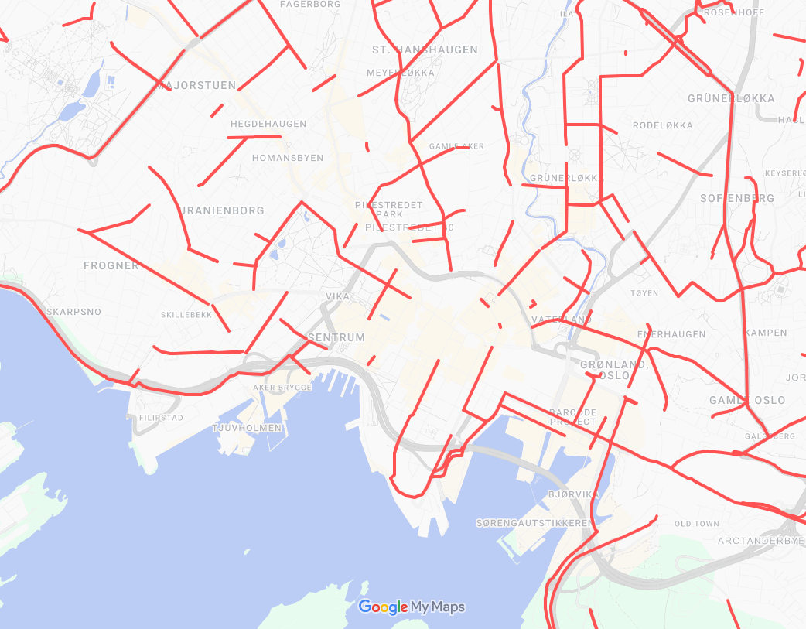
Data Sources
Sykkelruter i Oslo
(link)

Slide 10
Criteria
Popular public segment on Strava
No current bike lane overlapping segment
High average speed from single-user’s activities
High traffic
Low cost (low slope/incline, drivable road, high speed)

Slide 11
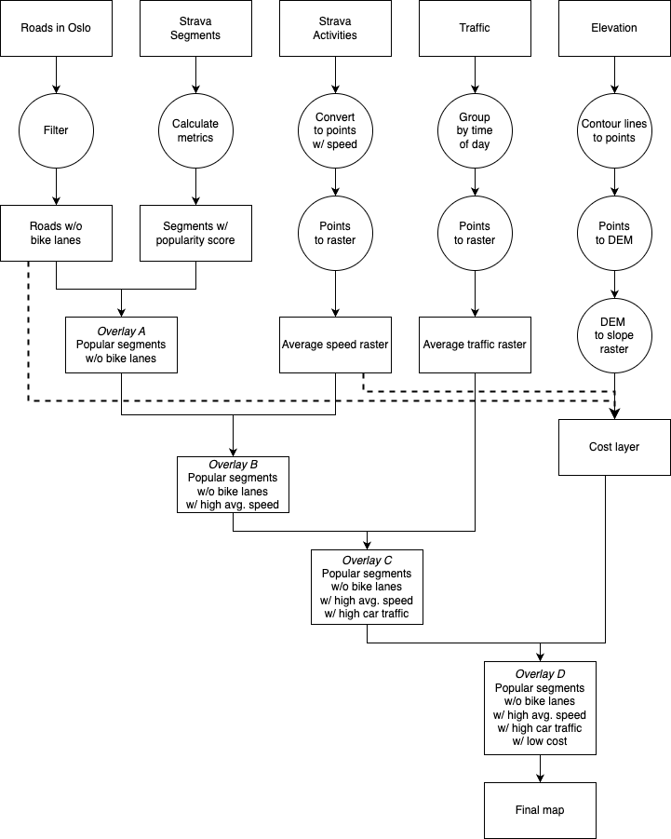
Flowchart
Criteria

Slide 12
Development: filtering and analyzing
Thresholds from empirical interpretation
Stricter thresholds to only keep most important segments
Control against domain knowledge
Agree with results along the way?

Slide 13
Development: bugs and problems
Programmatic reproducibility
Software licensing
Visualizing intermediate results
Coordinate system synchronization
Limitation of open-source algorithms
“Fair” normalization of raster values

Slide 14
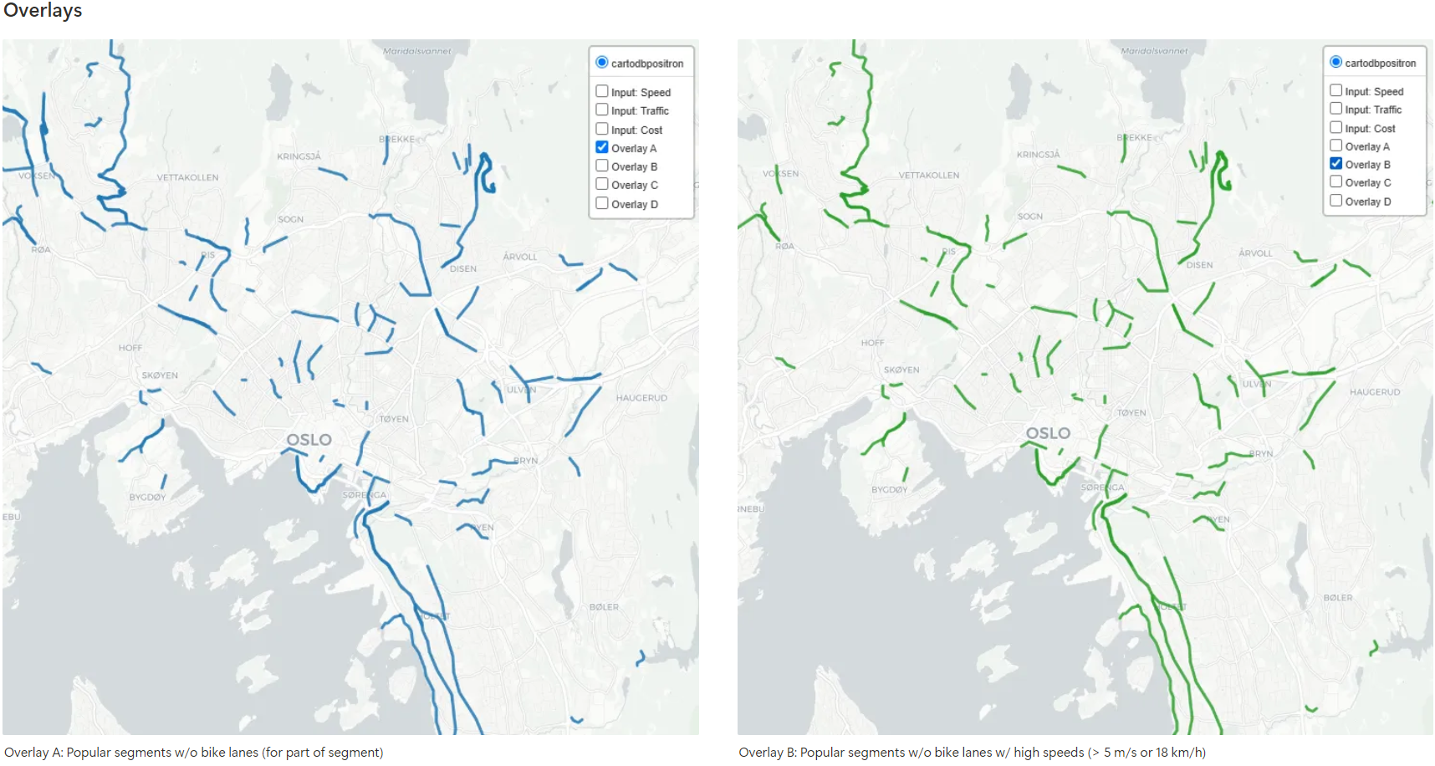
Results

Slide 15
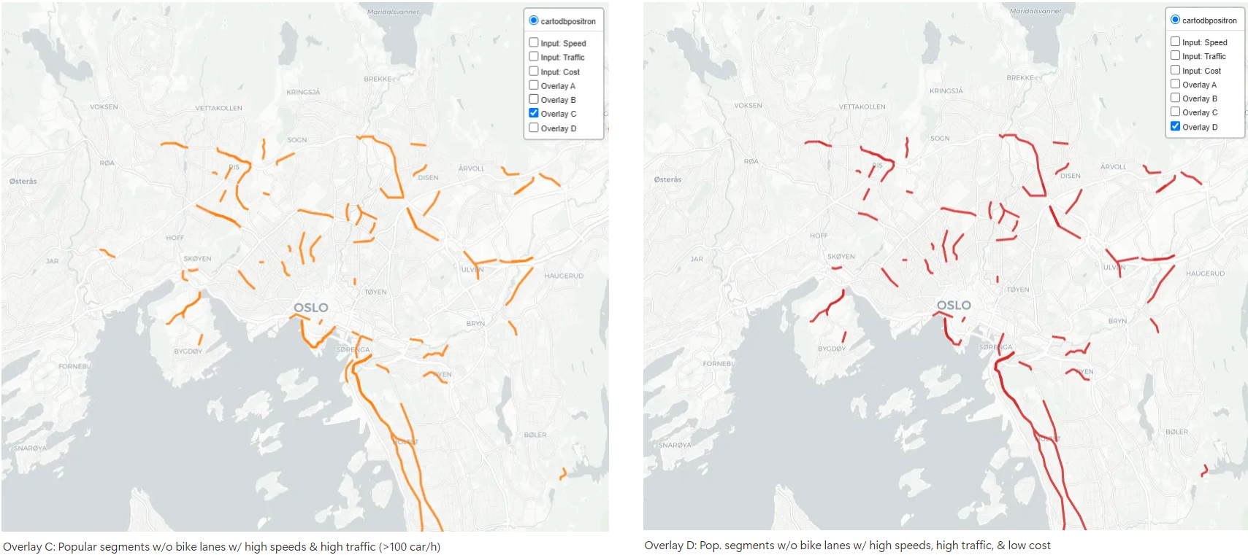
Results

Slide 16
Discussion
Weights versus thresholding
Polylines to buffer for proper differences
Raster for DEM
Cost: double use of layers (roads and speed)
Data bias:
Single user activities
Limited segment downloads
Traffic stations on highways

Slide 17
References
Source code: https://github.com/pmhalvor/geo4460/
Story Map: https://arcg.is/114PDX1
Strava API: https://developers.strava.com/docs/reference/
Statens Vegvesen API: https://trafikkdata.atlas.vegvesen.no/
N50 Map Data: https://kartkatalog.geonorge.no/metadata/n50-kartdata/ea192681-d039-42ec-b1bc-f3ce04c189ac
Sykkel ruter i Oslo (Oslo Kommune): https://www.google.com/maps/d/viewer?mid=1oO7FZepl8zXxKmx22yV91LUd1KZgYkU_&ll=59.9189196069674%2C10.75298007386504&z=14

